Slide 1
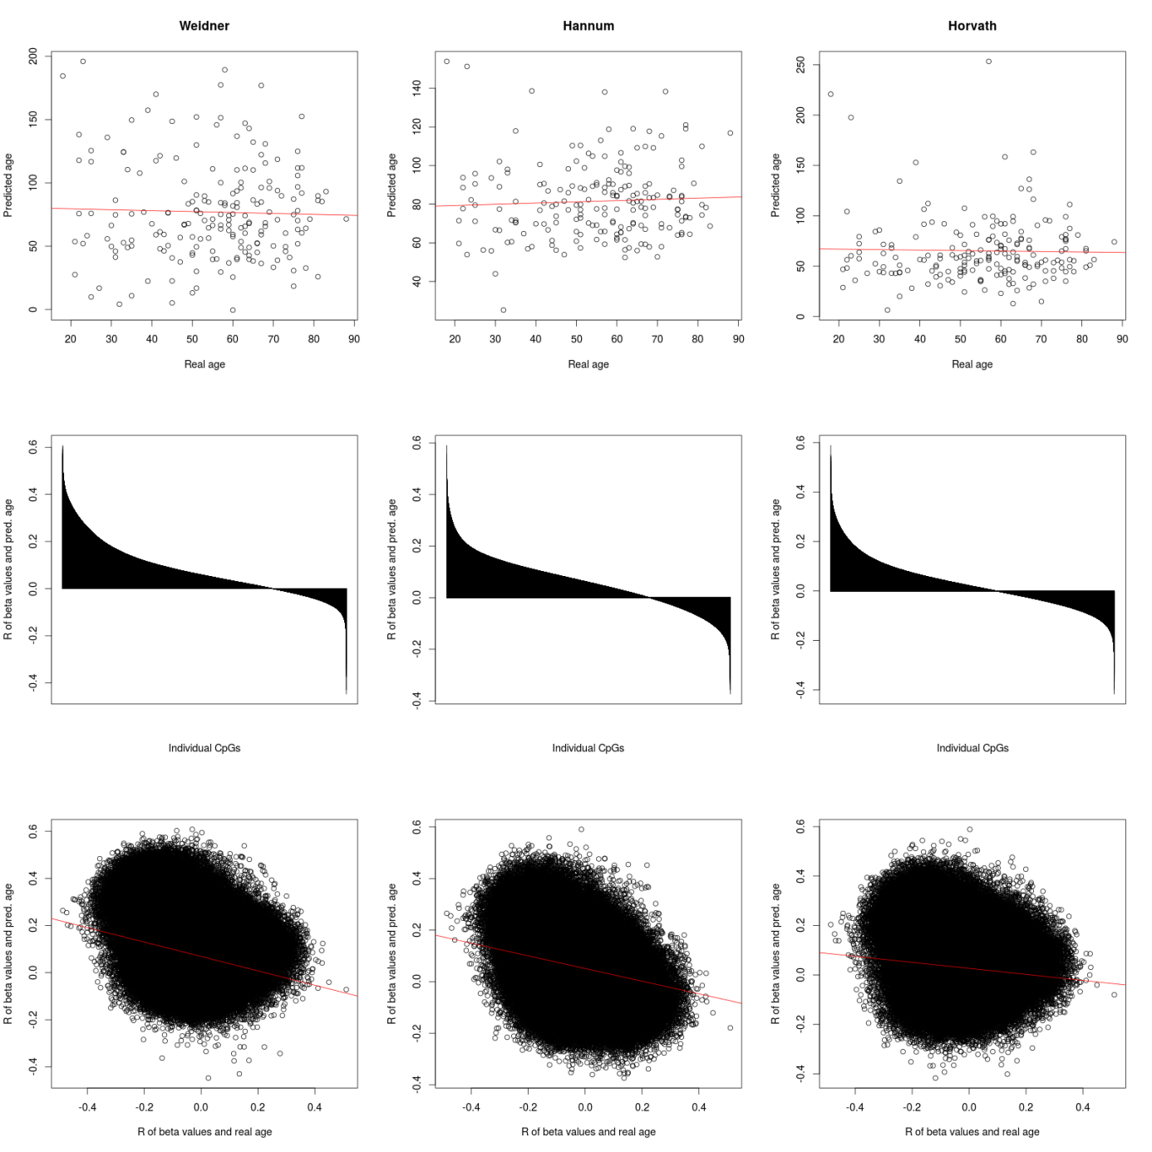
Needs more thinking – why are correlations of predicted and real age anti-correlated?

Slide 2
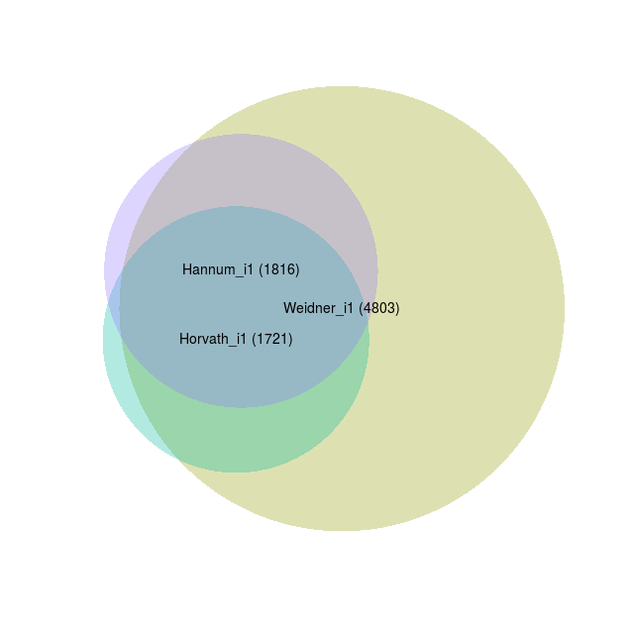
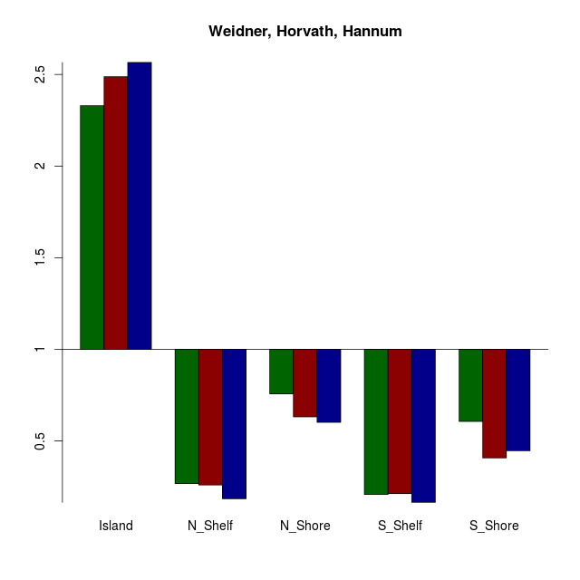
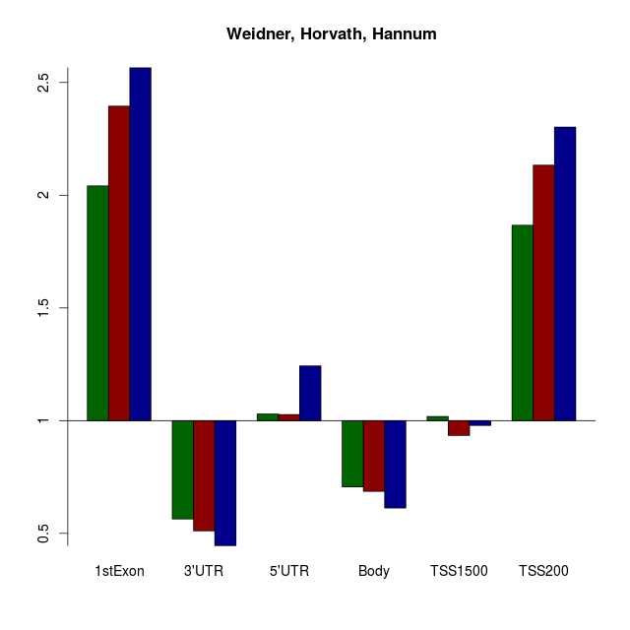
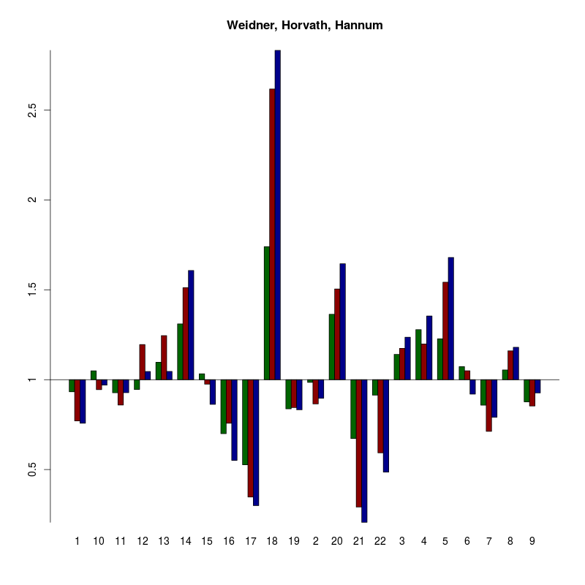
Variance filter >0.05
Correlation > 0.3
absolute
How is enrichment of normal age-associated CpGs (perhaps as comparison with similar parameters for the suppelment)
Ín this case it might be advantageous to change the graphical presentation to % of CpGs on y-axis (and to include an additinal bar for the background)
Enrichment in TF binding sites
Heat maps of co-correlation of CpGs with age-predictions (normal predictors and potentially 1 model of overlap) in the CpGs of the overlap in Venn Diagram above (((and potentially also age-associated CpGs of the normal age predictors)))[ or co-correlations of the 1 model in normal blood]
Association with histone code?
Reference might be unsorted blood? Preferentially CD34+ hematopoietic stem and progenitor cells…
Enrichment in chromosomal regions?
Enrichment in miRNA binding sites???

Slide 3
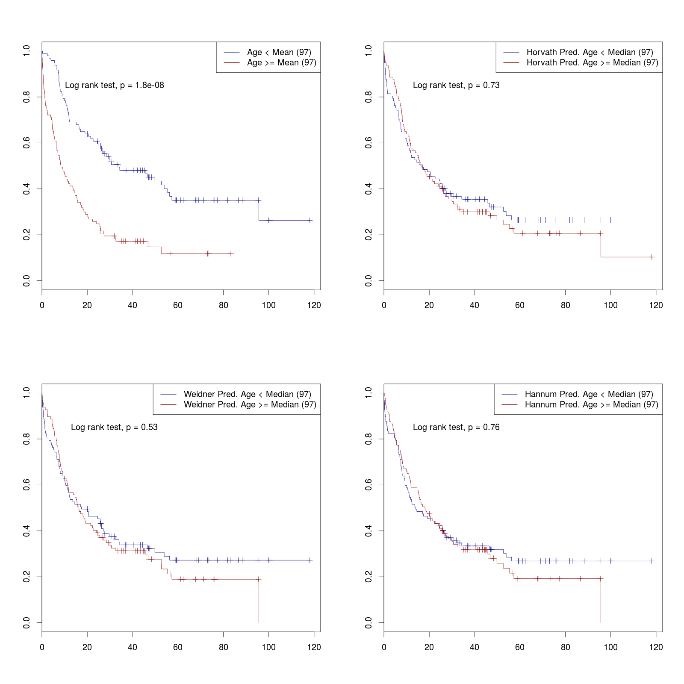
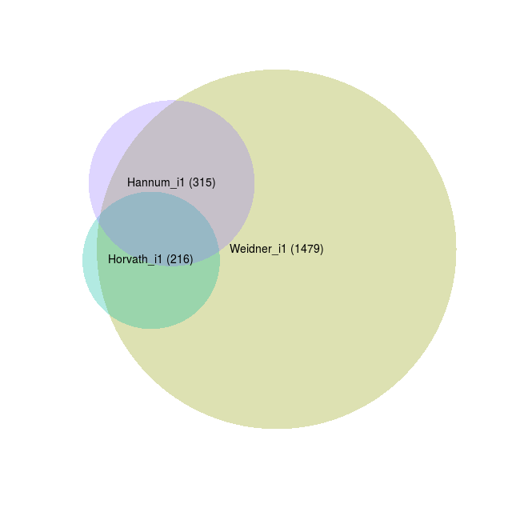
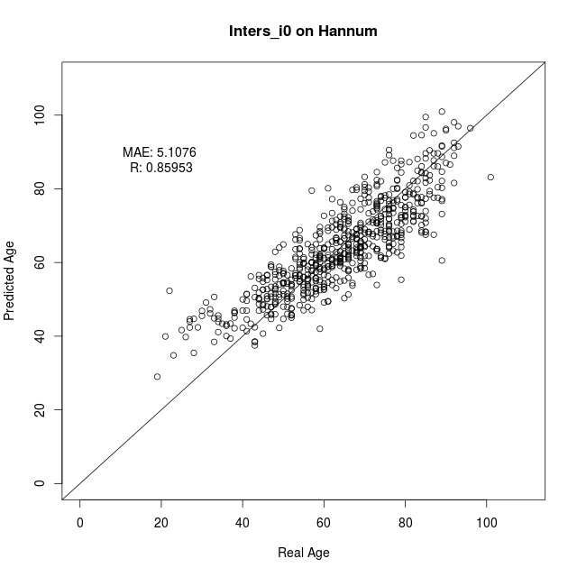
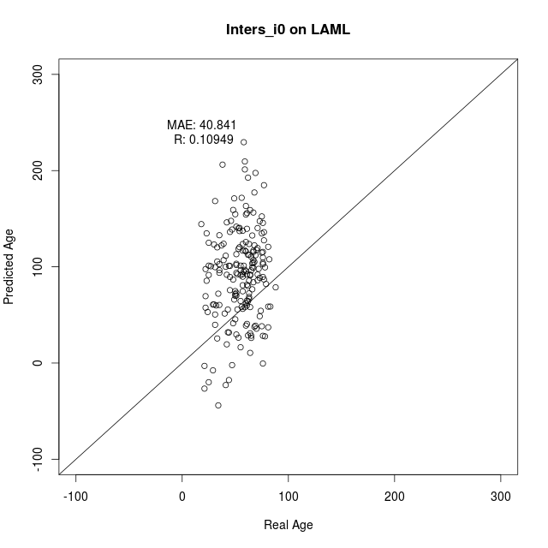
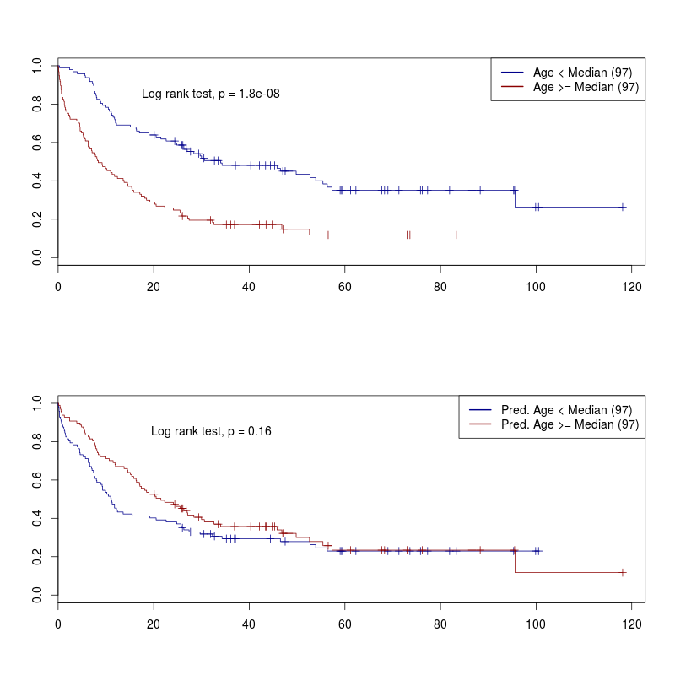
Variance filter >0.05
Correlation > 0.4
Only positive
99 CpGs in intersection of the three predictors – and all of them are exclusively positive.
These are used for retraining
… completely distinct from the Weidner 99 CpG model
Perhaps we should reduce to CpGs that are age-associated in Hannum before retraining the model?
COX Model might be informative (adjusted for age and gender)
We might also plot predicted vs. Real age in LAML using the 11 CpG Model.
More stringent filter (e.g. variance > 0.05 and correlation >0.45 – this would give 10 (11) CpGs that are applicable for MassARRAY… with the additional variance filter might be less…
Validatio n in other AML datasets:
Karolinska,
AML Halle
AML-AZA
…another on that Tanja downloaded…
?? Test signature on other tumors? Similar to table 1 in Lin and Wagner PLoS Genetics…. If then we ask Qiong
?? Perhaps we can subclone and anlayze DNAm in individual clones?? Furthermore, we can ask Monika who has analyzed individual subclones in normal CD34+ cells…

Slide 4
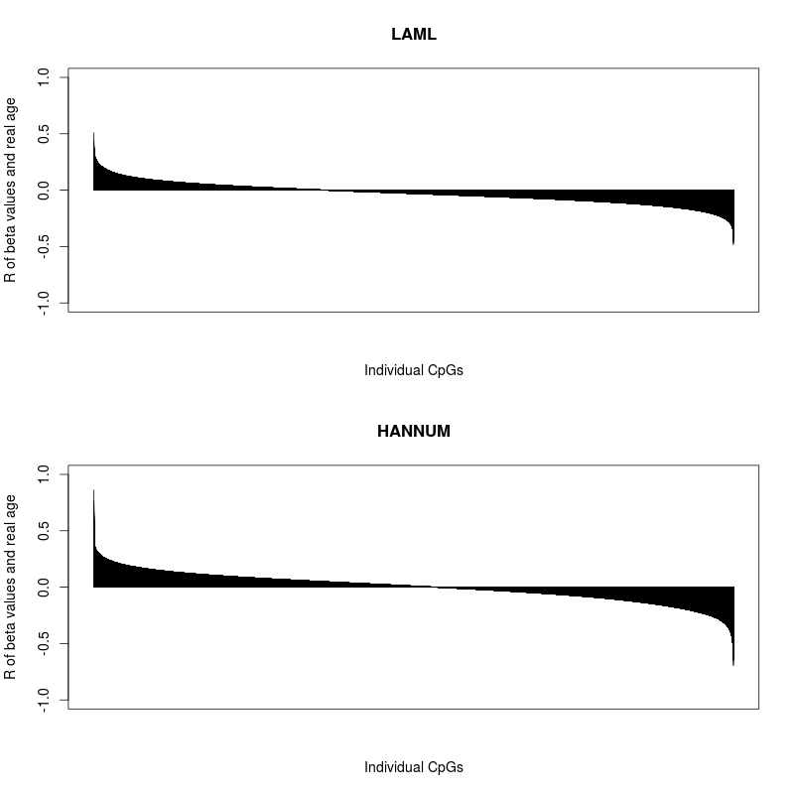
supplement

Slide 5
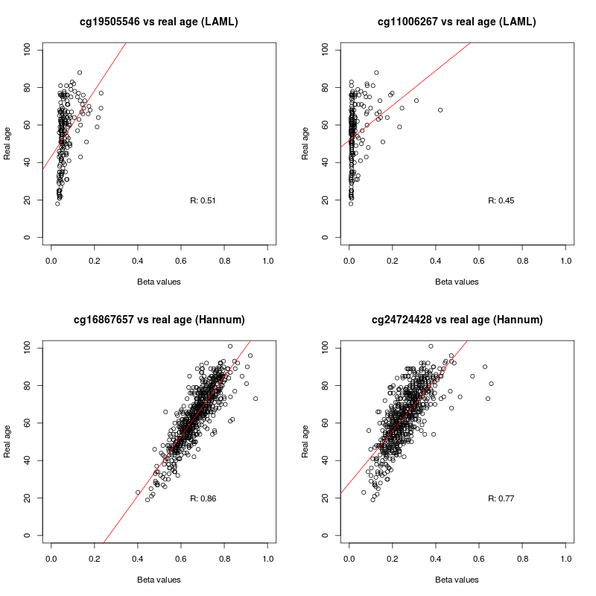
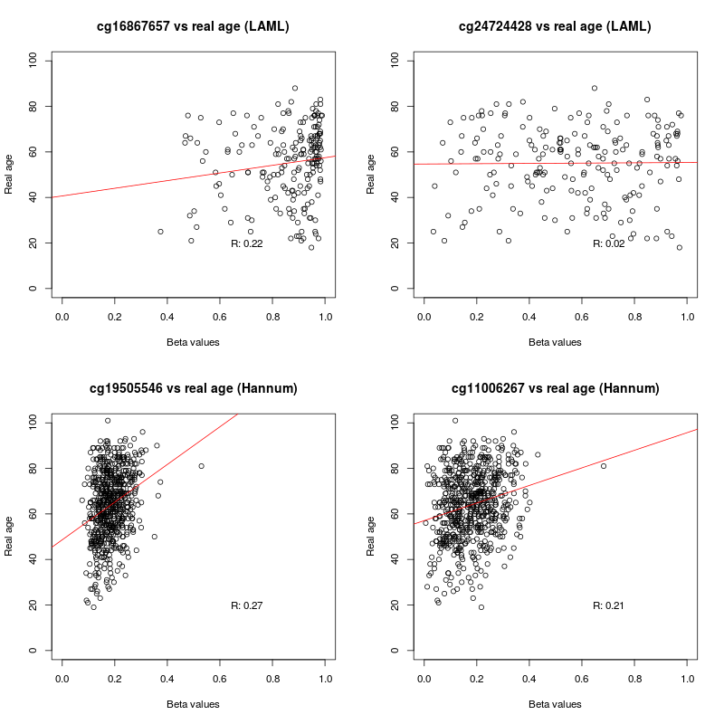
supplement
These are the best performing CpGs in TCGA and Hannum. Take home – there are no good performing individual CpGs in TCGA
Here the above mentioned CpGs are applied to the opposite dataset. They do not perform well on these datasets.

Slide 6
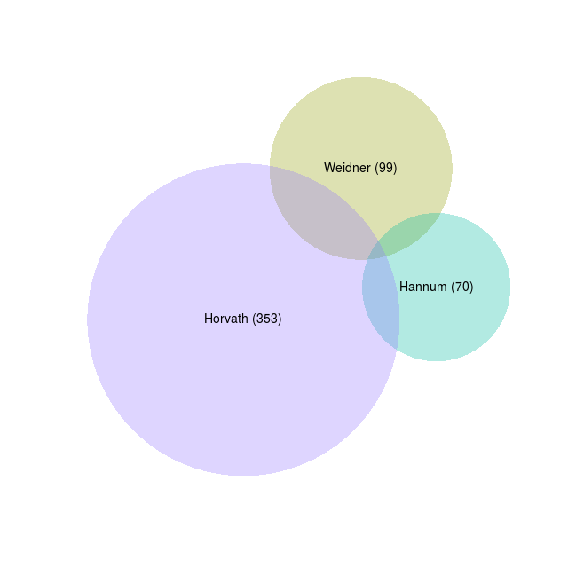
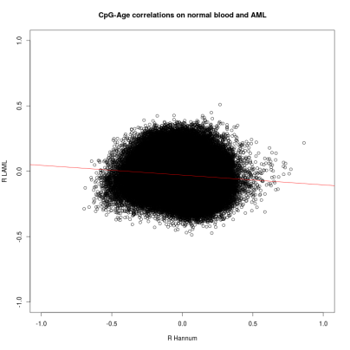

supplement
Variance filter >0.05
Correlation > 0.03
Only positive
Variance filter >0.05
Correlation > 0.03
Only negative

Slide 7
supplement

